Slide 1


WELCOME
TO
MY
CLASS

Slide 2
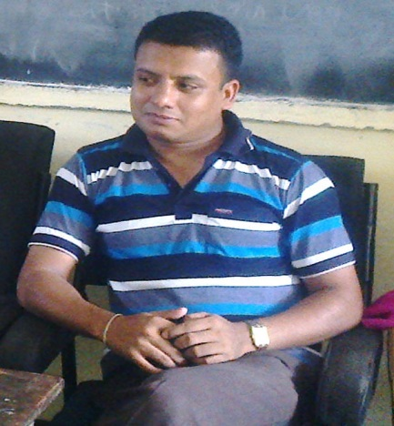
Edited by-
Karunamoy Dash
Asst. teacher (B.P.Ed)
Abdul Wahab High School,
Sreemangal, Moulvibazar
Mobile- 01712291793,
Email- mrityunjoy161@gmail.com
Greatful to-
MD.Nasir uddin (Bahar)
Assistant teacher (English), Jamila Khatun Chowdhury High School.
Mobile:01817204698, E-mail:baharfeni100@yahoo.com

Slide 3
Todays lesson-
NARRATION/ SPEECH
( INTERROGATIVE )

Slide 4



THE CHANGES OF TO BE & AUXILIARY VERBS
DIRECT
Am, is, are
Shall/will
Can
May
Must
Have/has to
Ought to
INDIRECT
Was/were
would
Could
Might
Had to

Slide 5
CHANGES OF ADVERB OF TIME & PLACE
DIRECT
NOW
TOMORROW
NEXT WEEK
TONIGHT
TODAY
YESTERDAY
LAST NIGHT
LAST WEEK
HERE
THIS
THESE
INDIRECT
THEN
THE NEXT DAY
THE FOLLOWING WEEK
THAT NIGHT
THAT DAY
THE PREVIOUS DAY
THE PREVIOUS NIGHT
THE PREVIOUS WEEK
THERE
THAT
THOSE

Slide 6

CHANGES OF TENSES
DIRECT
INDIRECT
SIMPLE PRESENT
SIMPLE PAST
PRESENT CONTINUOUS
PAST CONTINUOUS
PRESENT PERFECT
PAST ERFECT
SIMPLE PAST
PAST PERFECT
PAST CONTINUOUS
PAST PERFECT CONTUOUS

Slide 7
KINDS OF QUESTION
YES / NO
WH

Slide 8
IDENTIFICATION OF YES /NO & WH QUESTION
YES/ NO Q. - AUX. V. + SUB +………….?
WH Q - WH (What/ Which/ Who etc.)+.....?

Slide 9
Informations to change into indirect
YES / NO
WH
SAID -----
ASKED ----------
ASKED
, ------
IF / WHETHER-----
WH
Reported speech-
ASSERTIVE -----
ASSERTIVE ( rest of the reported speech after WH)

Slide 10
Yes/No Question Examples
DIRECT
1. Rocky said to Helen, “Does your father work here?”
2. Mr. Jamal asked Cinthia, “Have you collected your homework?”
3. Samia said to Peuly, “Can you accompany me to Dhaka tonight?
4. “Did you go to Dhaka last night?” Sana said to NODI.
5. Rina said to Sumi,”Won’t you do this again?”
INDIRECT
1. Rocky asked Helen if/whether her father worked there.
2. Mr. Jamal asked Cinthia if/whether she had collected her homework.
3. Samia asked Peuly if/whether she(p) could accompany her(s) to Dhaka that night.
4. Sana asked Nodi if/whether she had gone to Dhaka the previous night.
5. Rina asked Sumi if/whether she(s) wouldn’t do that again.

Slide 11

Wh- Question Example
DIRECT
1. The girl asked me, “Where do you live?”
2. My father asked my brother, “Why did you arrive at home late last night?”
3. Harun asked the girl, “Who is your favoruite movie star?
4. Laila said to the old man,”Why do you beg?”
INDIRECT
1. The girl asked me where I lived.
2. My father asked my brother why he(b) had arrived at home late the previous night.
3. Harun asked the girl who her favourite movie star was.
4. Laila asked the old man why he begged?

Slide 12
Questions in the passage narration
When a speaker tells two or more questions one after another-
1st said----- asked
2nd said---- again asked/ also asked

Slide 13
EVaLUaTION
Oral solution-
Try to say what you will use at the place of said, comma and what you will change of reported speech of the following passage-
“Why are you wasting your time? Your exam is knocking at the door. Do you know this?”Father satd to the son.

Slide 14
Exercise at home
DIRECT
1.Palak asked Leena, “I am very happy to see you. Where are you going? Can you help me?”
2.My father asked me, “Have you prepared for your final exam? Why are you sleeping now?”
3. Mina said to her mother, “What are cooking? Can’t you make hurry? I am very hungry.”

Slide 15




Thank you for bearing with me.
Good bye

